Slide 1
RAJALAKSHMI ENGINEERING COLLEGE
Department of Artificial Intelligence and Machine Learning
AI19511 MOBILE APPLICATION DEVELOPMENT LABORATORY FOR ML AND DL APPLICATIONS
MINI PROJECT
Cancer Detection App
Project by,
Jayashrinidhi V(221501053)
Prajein C K (221501189)
1

Slide 2
OUTLINE
Abstract
Objective
Problem solution
Methodology
Results and discussions
Conclusions
References
2

Slide 3
ABSTRACT
Cancer remains one of the leading causes of mortality worldwide, making early detection critical for effective treatment and improved survival rates. This project presents a deep learning-driven mobile application designed to aid in the early diagnosis of cancer, combining Convolutional Neural Networks (CNNs) for image-based classification with React Native Expo for seamless cross-platform development. The application processes medical images, identifying potential cancerous regions with high precision and speed. By leveraging state-of-the-art machine learning algorithms, the system offers robust performance in detecting abnormalities across various cancer types.
The React Native framework ensures compatibility across Android and iOS platforms, providing a user-friendly and accessible interface for both healthcare professionals and patients. The app also features a secure backend for managing sensitive user data, ensuring compliance with privacy regulations. Performance evaluation based on metrics like accuracy, sensitivity, specificity, and F1-score validates the reliability of the system. This work demonstrates the transformative potential of artificial intelligence in healthcare, aiming to bridge the gap between cutting-edge diagnostic technology and its accessibility in resource-limited settings. The project is a step toward democratizing healthcare, empowering individuals with a portable, affordable, and efficient diagnostic solution.
4

Slide 4
OBJECTIVE
This mobile app’s uses its potential to democratize access to cancer screening tools. This makes it a very important link in the healthcare system. For instance, a lot of people have no alternative healthcare services due to the area they live in, financial constraints, or ignorance about cancer symptoms. The user-friendly interface of the mobile phone that lets a person test cancer danger from skin with the data collected by the smartphone will help these problems of access and awareness
3

Slide 5
PROBLEM SOLUTION
Globally, cancer is a major health issue, cutting across different ethnic groups and areas with millions of people diagnosed with it every year. The World Health Organization estimates that cancer will be the leading cause of death globally sooner than cardiovascular diseases. Early diagnosis is key to improving treatment outcomes and sustaining life in cases of severe types of cancer such as melanoma, breast cancer, and lung cancer. The data has over and over shown that if cancer is detected at an early stage, the chances of successful treatment and long-term survival are high. Technology has brought about mobile apps that are now very important tools in enabling early cancer detection and in encouraging patient participation. Among these technologies, deep learning (DL) is the one which is most remarkable due to its high-performance capability in analyzing complicated medical images with high accuracy.
The planned mobile app will use deep learning algorithms to recognize skin cancer through image analysis. By leveraging convolutional neural networks (CNNs) which are basically used in image classification tasks, the app will analyze the skin lesions to figure out whether they are benign or malignant. The users can take photographs of their skin lesions with their smartphones, and the app will give them instant feedback as well as give suggestions for further action such as visiting a healthcare professional. This tactic aside from helping people to stay in control of their own health also makes the work of healthcare workers easier as they only take it from there by doing an initial assessment and thus excess people from clinics come in due to minor issues.
5

Slide 6
METHODOLOGY
The proposed cancer prediction and treatment recommendation system utilizes a convolutional neural network (CNN) as its core algorithm. Here's an explanation of how this algorithm works and its key components:
Architecture:
  A CNN typically consists of several layers, including convolutional layers, activation functions, pooling layers, and fully connected layers.
  For this project, the architecture includes multiple convolutional layers followed by max-pooling layers, a flattening layer, and dense layers for classification.
Convolutional Layers:
  Function: These layers apply convolution operations to the input images, using a set of learnable filters (kernels) that slide across the image to detect features such as edges, textures, and patterns.
  Process: Each filter generates a feature map that highlights the presence of specific features in the image. This helps the model learn various aspects of plant leaves, which are crucial for disease identification.
Activation Function:
  ReLU (Rectified Linear Unit): This activation function is commonly used in CNNs because it introduces non-linearity, allowing the network to learn complex patterns. It outputs zero for negative inputs and the input itself for positive inputs.
12

Slide 7
METHODOLOGY
Pooling Layers:
  Max Pooling: Following the convolutional layers, max pooling layers downsample the feature maps by taking the maximum value from a specified window (e.g., 2x2). This reduces the spatial dimensions of the feature maps, retaining the most important information while decreasing the computational complexity.
Flattening:
  The output from the pooling layers is flattened into a one-dimensional array, which serves as the input for the fully connected layers. This step prepares the extracted features for classification.
Fully Connected Layers:
  These layers consist of neurons that are fully connected to the previous layer. The final dense layer has a number of neurons equal to the number of disease classes, using the softmax activation function to output a probability distribution across the classes.
Loss Function:
  The categorical cross-entropy loss function is used to measure the difference between the predicted class probabilities and the actual class labels. The goal of training is to minimize this loss.
Optimizer:
  The Adam optimizer is utilized for training the model, which adjusts the learning rate during the training process for improved convergence.
13

Slide 8
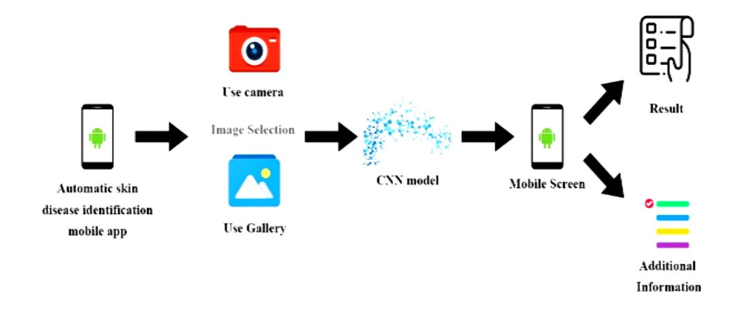
ARCHITECTURAL DESIGN FOR PROPOSED SYSTEM
10

Slide 9
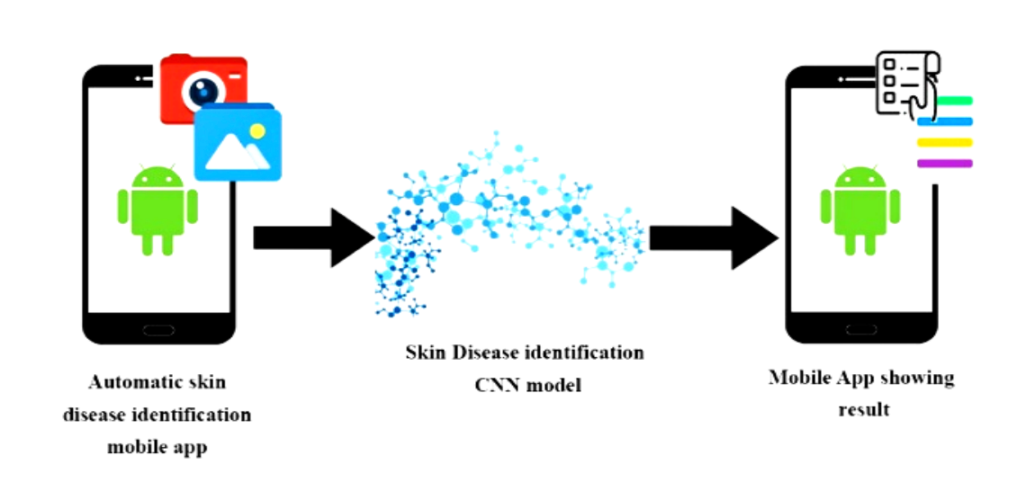
ER/ USE CASE DIAGRAM
11

Slide 10
Results and Discussions
Many problems have been detected during the evaluation process. For a start, a notable issue was the different levels of image quality preferred by participants. Some images had low details and were not clear, this is likely to affect classification accuracy. To solve this problem, the app's future versions could involve users' instructions or tips on how to take high-quality images for analysis.
Moreover, although the application did show a remarkably high level of performance under the conditions of the pilot, larger-sized and more diverse samples are the areas of the incoming research, and further validation is needed to determine that the system can generalize across various demographics and skin types. A wider and varied dataset will assist in the model gaining robustness and eliminating the issues of underrepresented groups.
One more thing that can be improved is the implementation of a feedback mechanism when users report their results after the application gives its recommendations. The AI model would be receiving such information as data from its actual usage, thereby constructing a virtuous circle of learning.
To sum it all up, these results show that a mobile application that is built upon deep learning for cancer detection can be very useful in early diagnosis and patient education concerning skin cancer. The benefits of the joint usage of tech and design solutions will be harnessed by empowering individuals to own their health management and thus addressing rapid medical interventions are also made easy.
14

Slide 11
Conclusion
This study evaluated the recent developments in deep learning for medical image analysis and showed that AI-based methods can significantly reduce diagnostics and healthcare costs by building a bone fracture detector.. The studies highlight deep learning's capacity to improve the accuracy of detecting and classifying medical conditions, e.g. fractures, lung diseases, and tumors from various imaging modalities. CNNs make the top list in the successes of image classification, the use of transfer learning is beneficial in small datasets, and deep learning works well in complex tasks like tumor segmentation are the key findings. As such, CNN and VGG16 have been made use of to build this bone fracture detection model.
Even though these improvements have occurred, the issues of ensuring that the models generalize to diverse patient demographics and imaging environments still persist. For clinical adoption of the model to be widespread, the need for robust data, better interpretability of model predictions, and regulatory frameworks are also required. Future studies should emphasize approaching these limitations by means of federated learning, explainable AI, and synthetic data generation which will enable scaled, safe, and equitable use of deep learning in healthcare.
In a nutshell, besides the fact that deep learning has made tremendous progress in medical image analysis, functional integration into clinical workflows continues to demand further innovation and validation. Dependent on the result of research and cooperative engagement, deep learning is likely to reach a position of a key player for many diagnoses and treatments, thus making a positive contribution to the healthcare systems worldwide
18

Slide 12
REFERENCES
[1] Ball, G. et al. 2002. An integrated approach utilizing artificial neural networks and SELDI mass spectrometry for the classification of human tumors and rapid identification of potential biomarkers. Bioinformatics 18: 395–404.
[2] Li, J. et al. 2002. Proteomics and bioinformatics approaches for identification of serum biomarkers to detect breast cancer
[3] Schafer, J.L. 1997. Analysis of Incomplete Multivariate Data. No. 72 of Monographs on Statistics and Applied Probability. Chapman & Hall/CRC. London.
[4] Hoffman, P. & G. Grinstein. 2000. Multidimensional information visualization for data mining with application for machine learning classifiers. In Information Visualization in Data Mining and Knowledge Discovery. Morgan Kaufmann. San Francisco.
[5]B. M. Gayathri and C. P. Sumathi, "Comparative study of relevance vector machine with various machine learning techniques used for detecting breast cancer", 2016.
19

Slide 13
THANK YOU
20

